Slide 1


NASA SPACEAPPS CHALLENGE 2023
THE IRISH MOONQUAKERS
MAKE A MOONQUAKE MAP 2.0
APOLLO 16
APOLLO 14
APOLLO 12

Slide 2

CHALLENGE
To develop an interactive web app for the public to visualise lunar seismic events detected during apollo missions on a 3d moon model.
OBJECTIVES:
Cleanup retrieved PSE seismic data, plot time-series seismographs and integrate with the 3d moon model.
Visualise locations of shallow and A1 deep moonquakes on the 3d moon model.
Predictive analysis on shallow & A1 deep moonquakes by applying machine learning models on available PSE data.
1969
1969
1971
1971
1972
APOLLO 11
APOLLO 12
APOLLO 14
APOLLO 15
APOLLO 16

Slide 3


METHOD
Backend
Model
Collect data from existing moonquake catalogs, compare it, and retrieve PSE measurements for the identified moonquake events.
Create a 3D model of the moon including topographic features
API
Frontend
Develop an API to feed the processed data to the web app
Get in depth details of the quakes based on event time, quake classification, location, and magnitude.

Slide 4
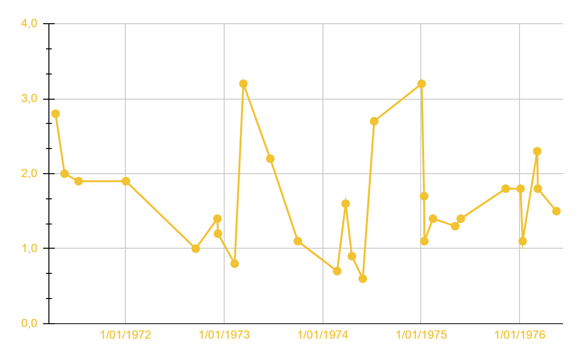
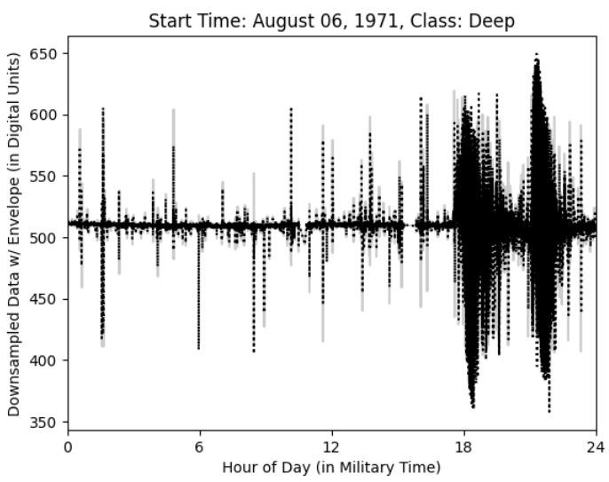
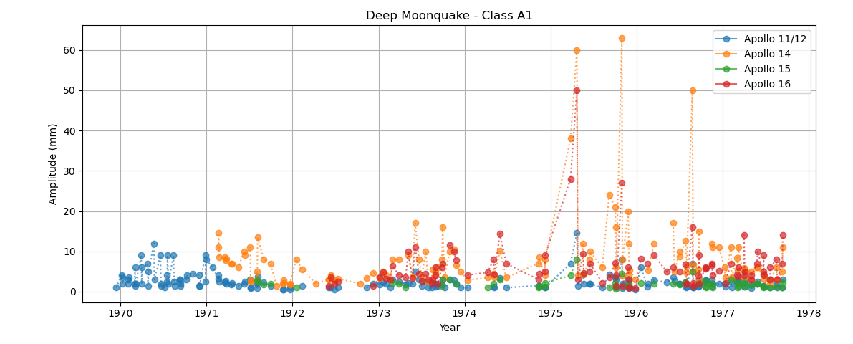
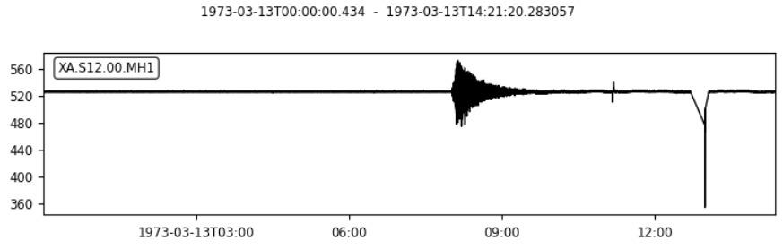
RESULTS
Time series plot of shallow moonquakes
Seismograph of a deep moonquake
Time series plot of A1 deep moonquakes
Seismograph of a shallow moonquake

Slide 5
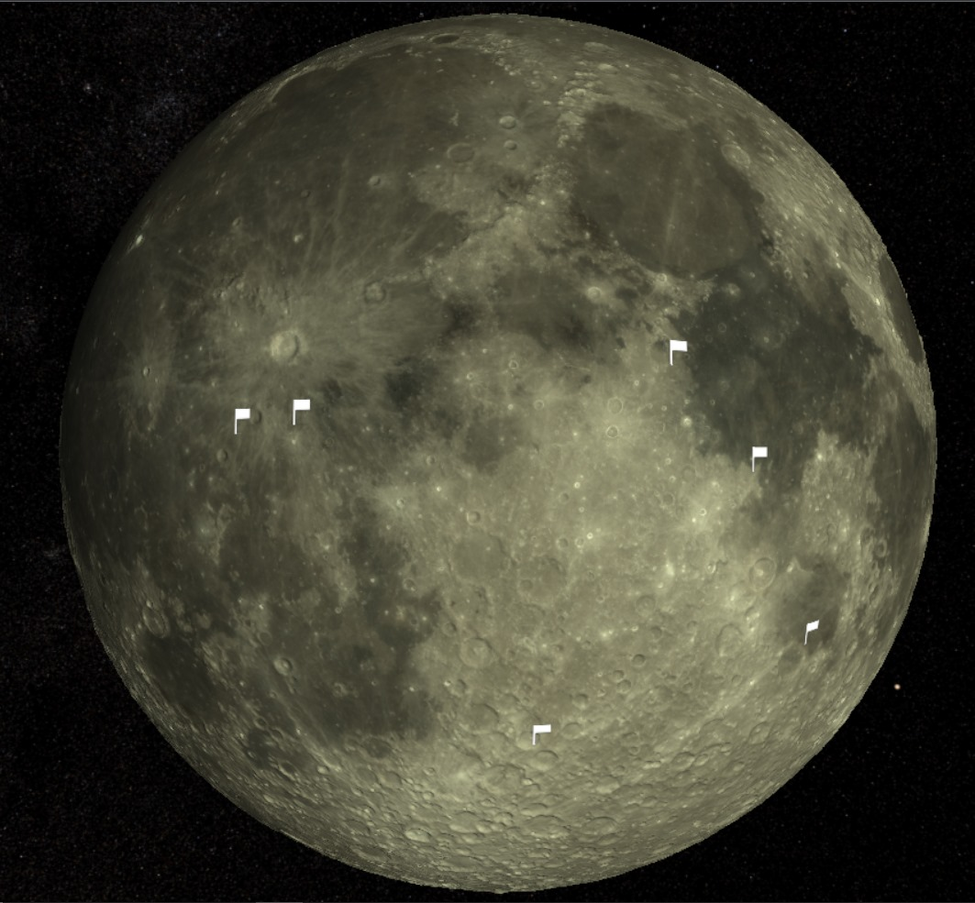
RESULTS
Developed an interactive 3d moon model using Babylon.js
Mapped Apollo landing sites* to demonstrate the capability to map specific locations on the 3D moon model.
The model includes topographic features on the moon surface which provides a more realistic and immersive experience to the user.
Users can zoom in/out, spin and explore various regions on the lunar surface.
*white flags in the image

Slide 6
FUTURE DEVELOPMENTS
DATA CLEANING
PREDICTIVE ANALYSIS
Apply corrections to data inaccuracies, time errors.
Time series forecasting/applying HMM on recorded PSE data, coordinates info
1
2
3
4
FRONT END
DATA CLASSIFICATION
Identify patterns in unclassified quakes by using ML algorithms.
Competitive analysis with earthquake data
Add timescale sliders, ripples/torus visuals to represent seismic activity

Slide 7

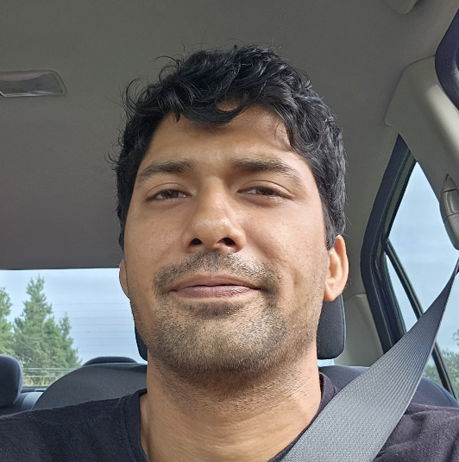
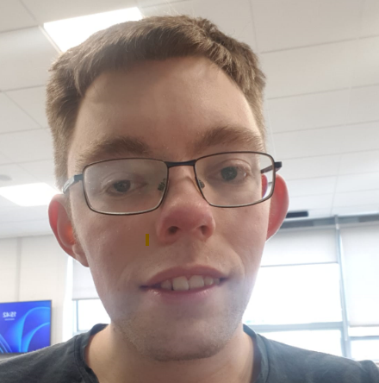


THE TEAM
WILSON CHEUNG
SANCHIT BAHN
ALEXANDER NUZUM
RABIN WILLIAM
RAJRATAN
Data Processing, Seismic Analysis
API Development
3D modelling, UI development
Data processing/visualization
Web UI development
PLEASE KEEP THIS SLIDE FOR ATTRIBUTION

